Slide 1
Normal Distribution

Slide 2
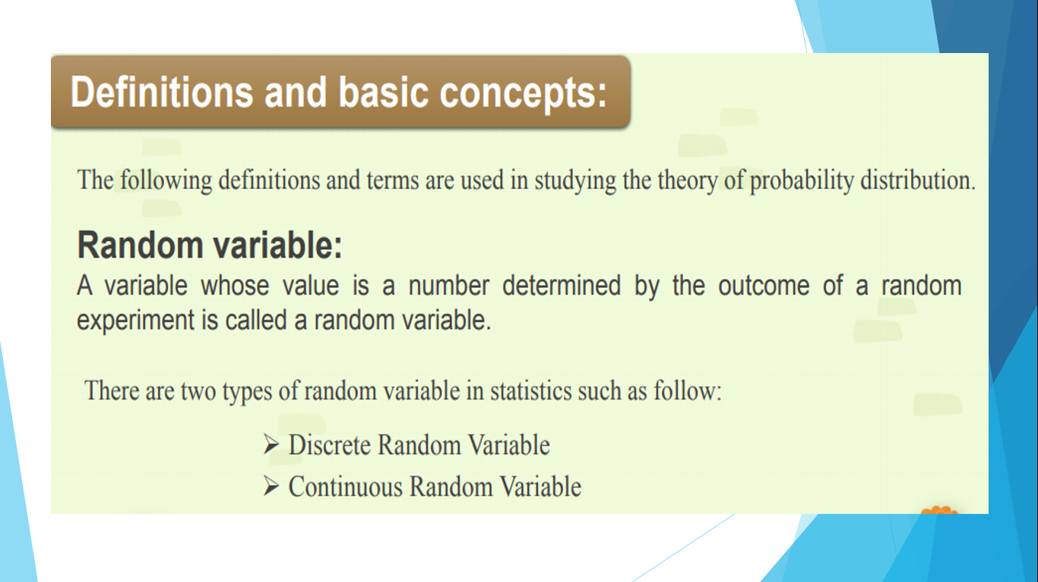

Slide 3



Slide 4
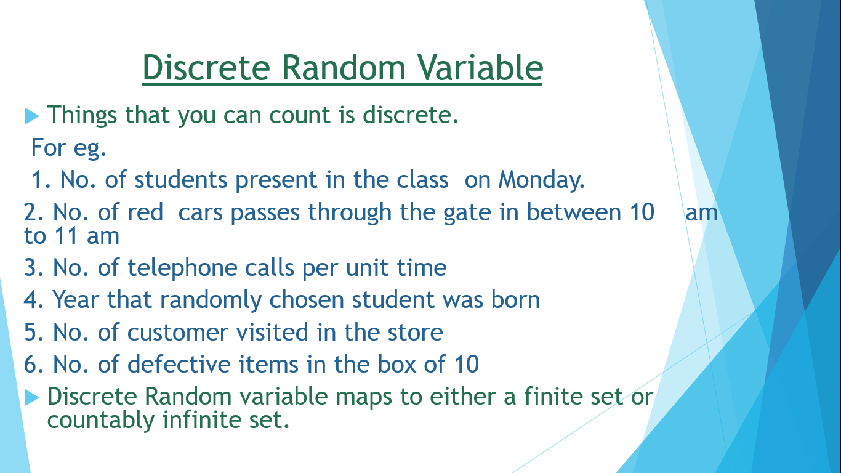

Slide 5
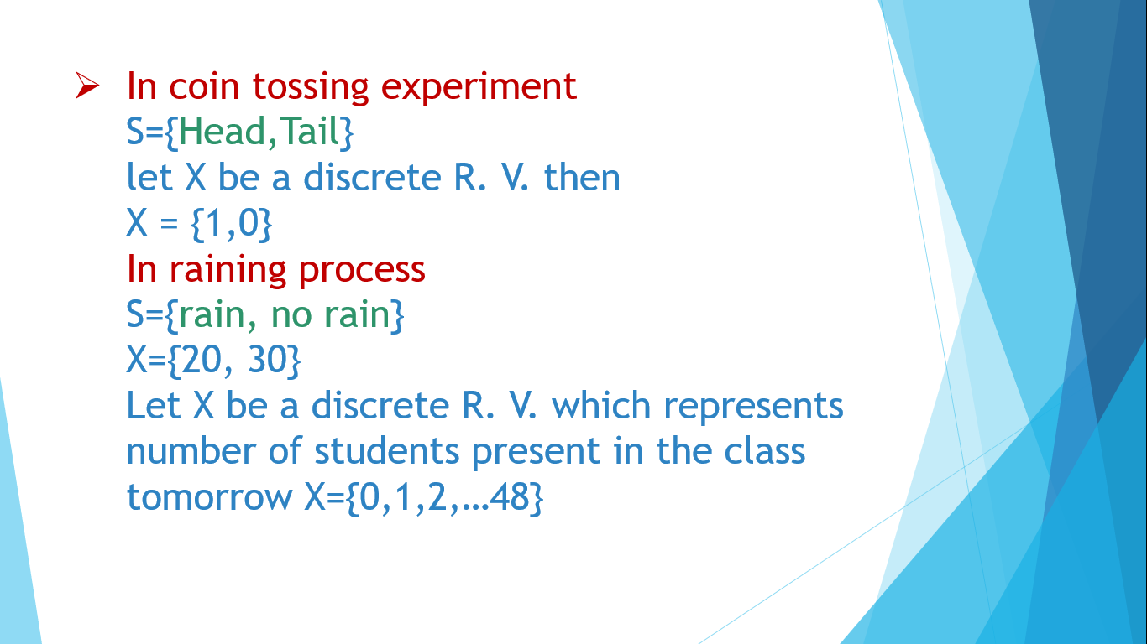

Slide 6
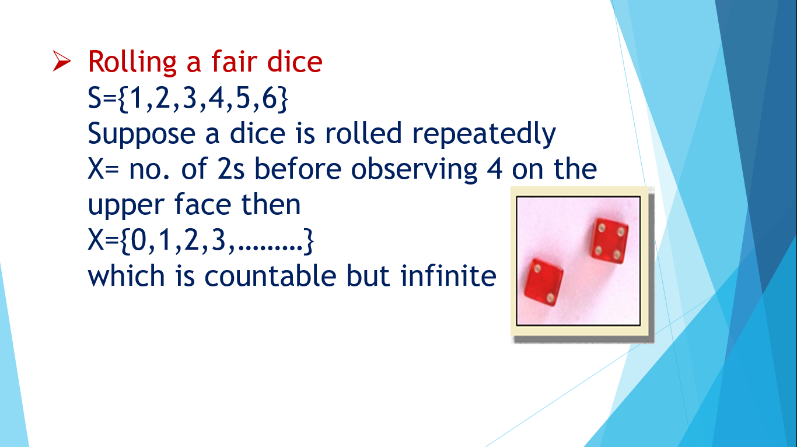

Slide 7
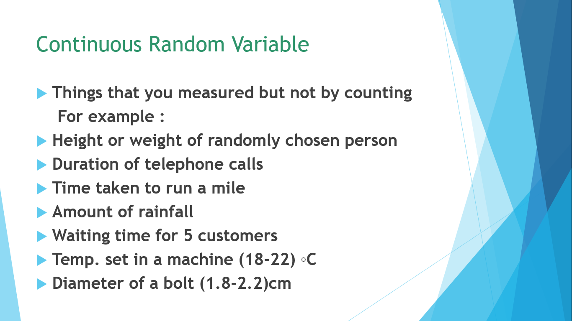

Slide 8
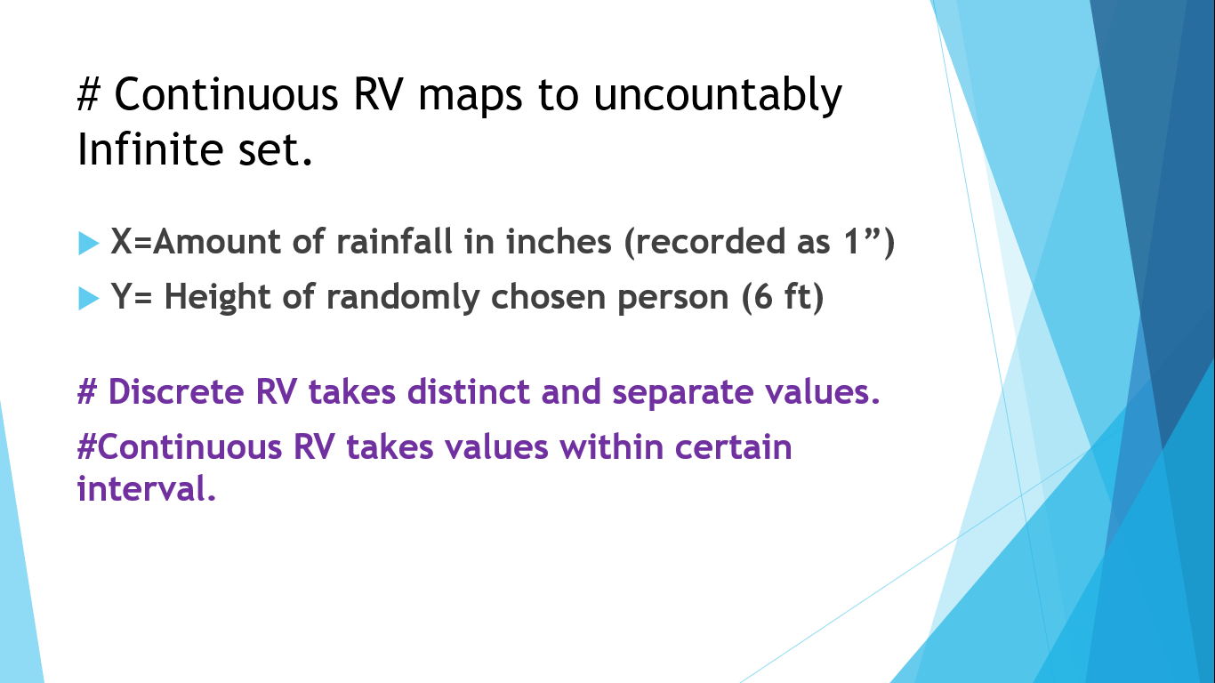

Slide 9
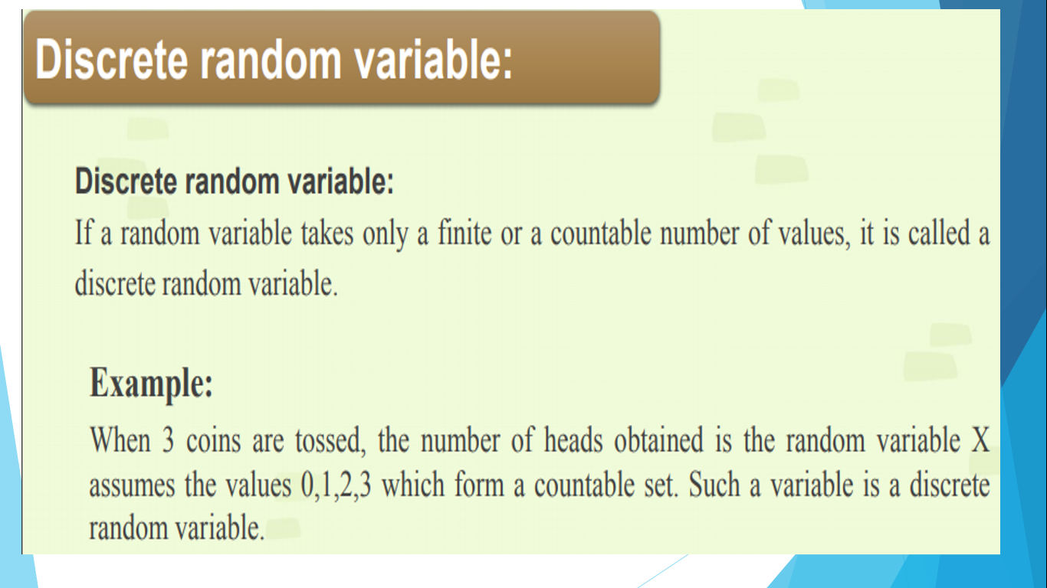

Slide 10
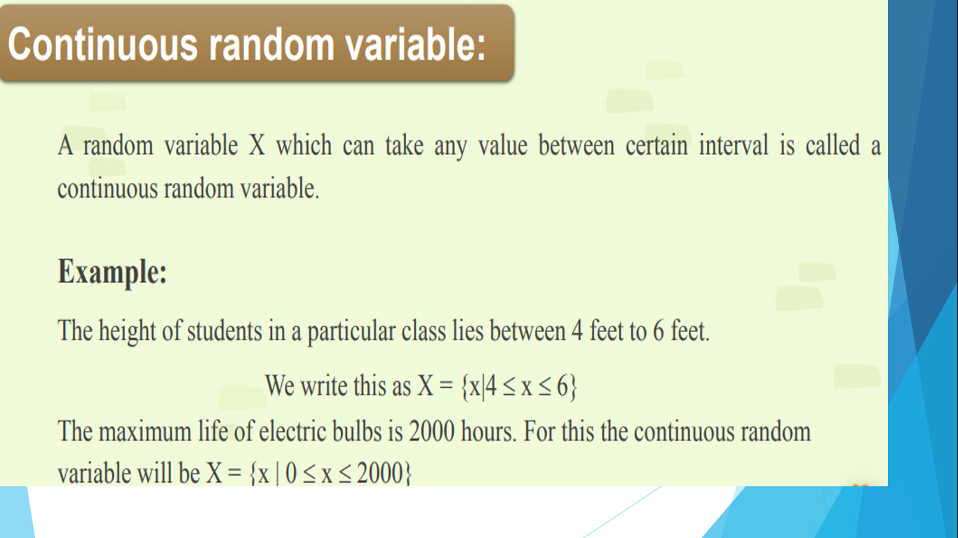

Slide 11
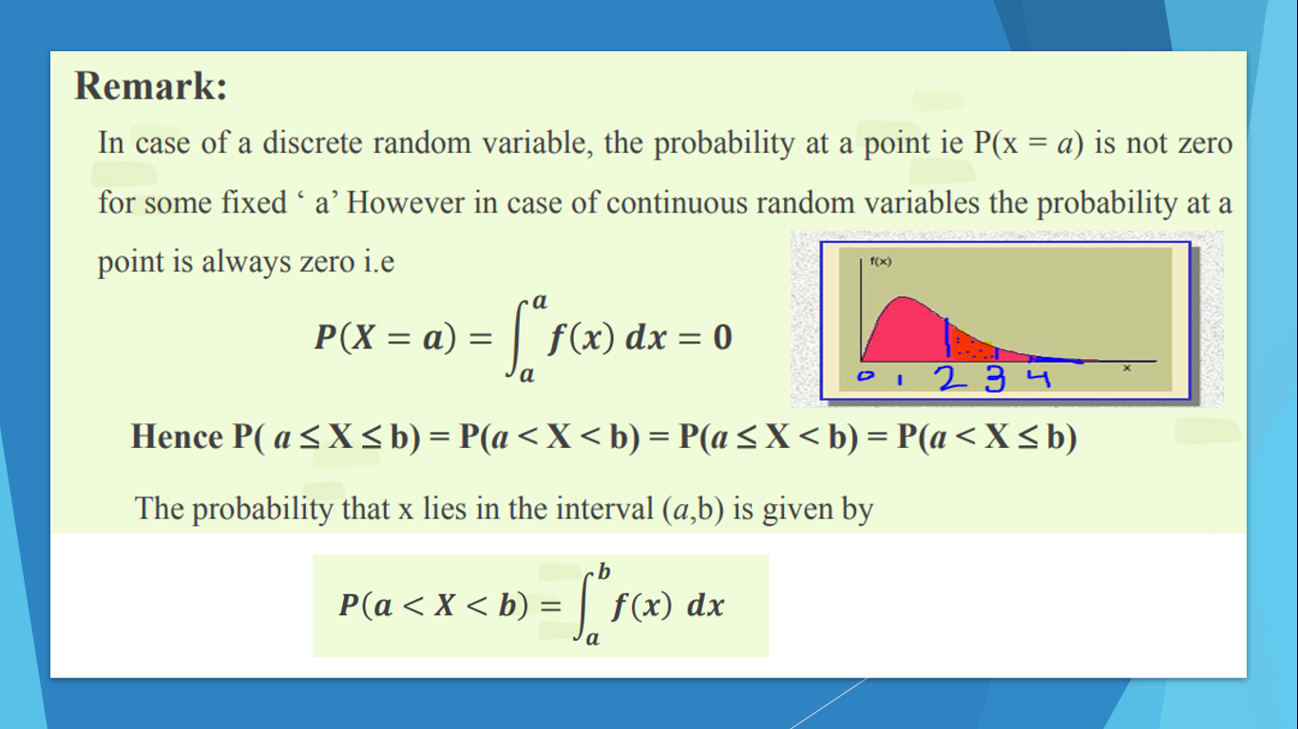
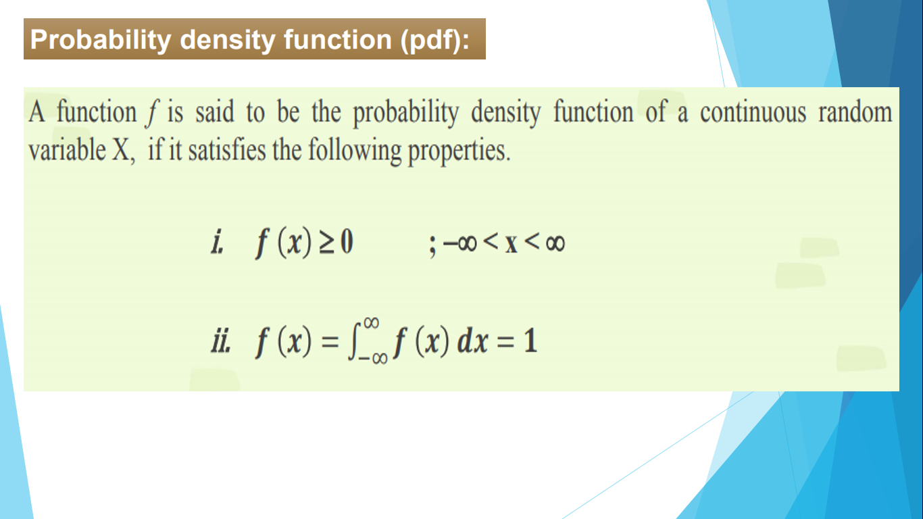
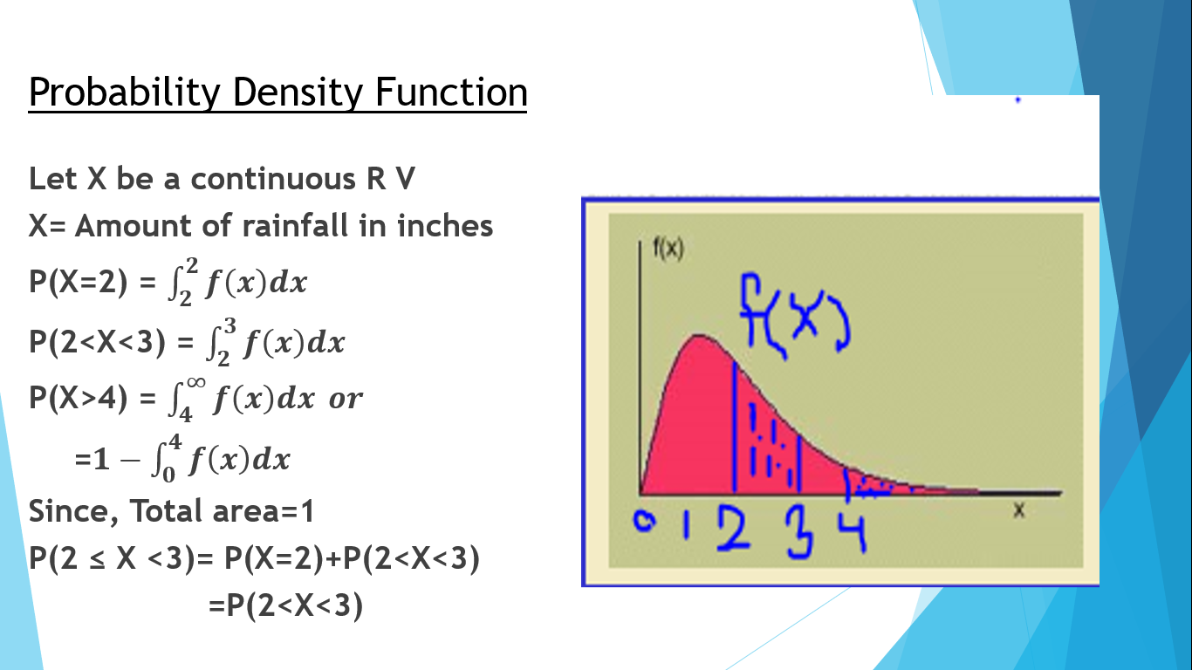
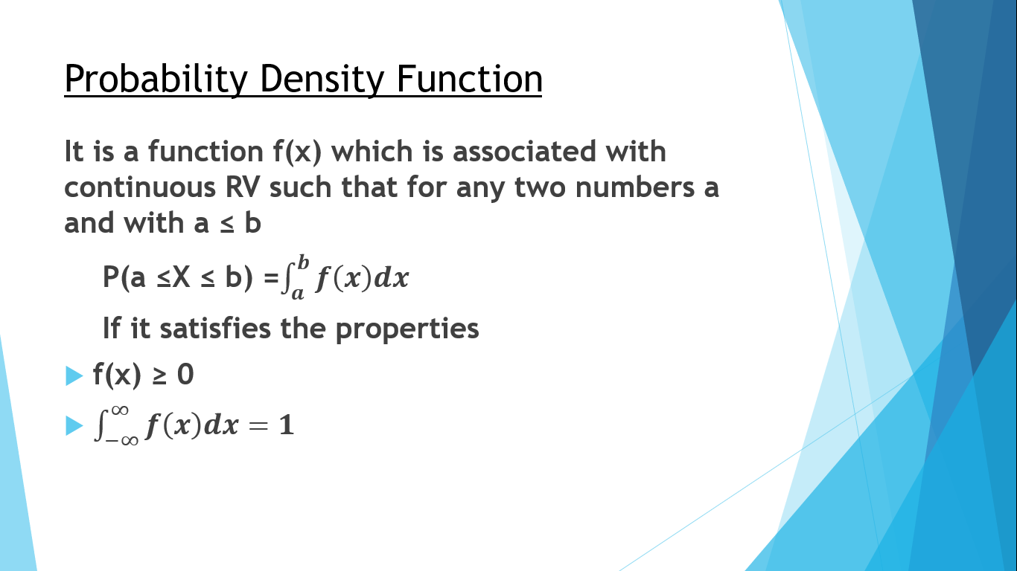
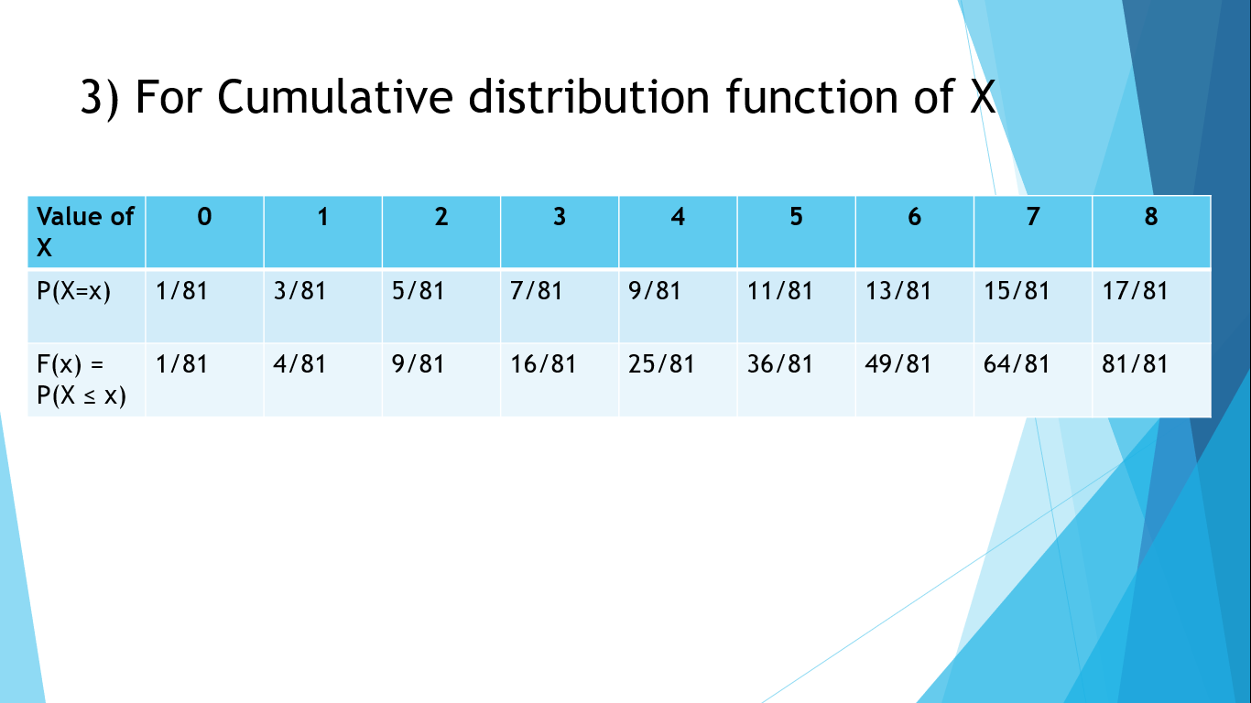
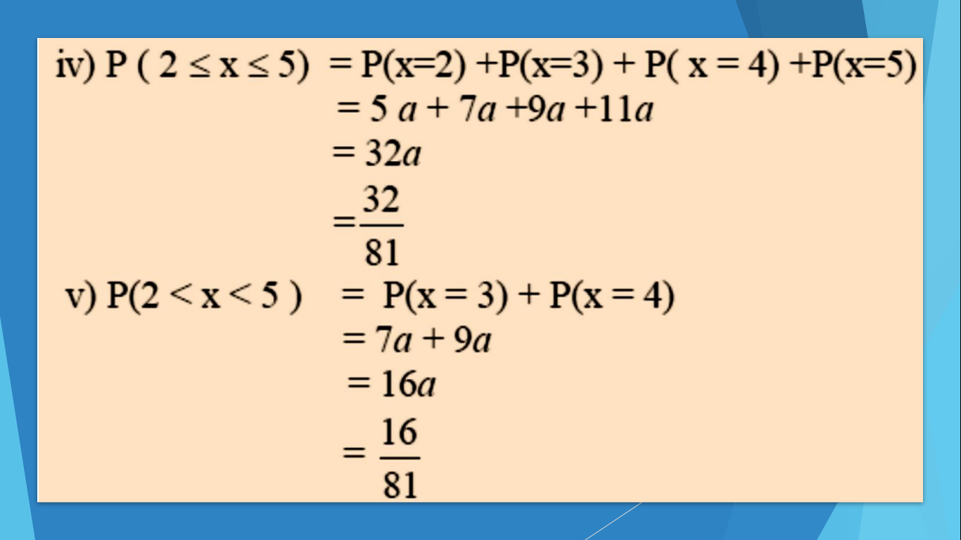
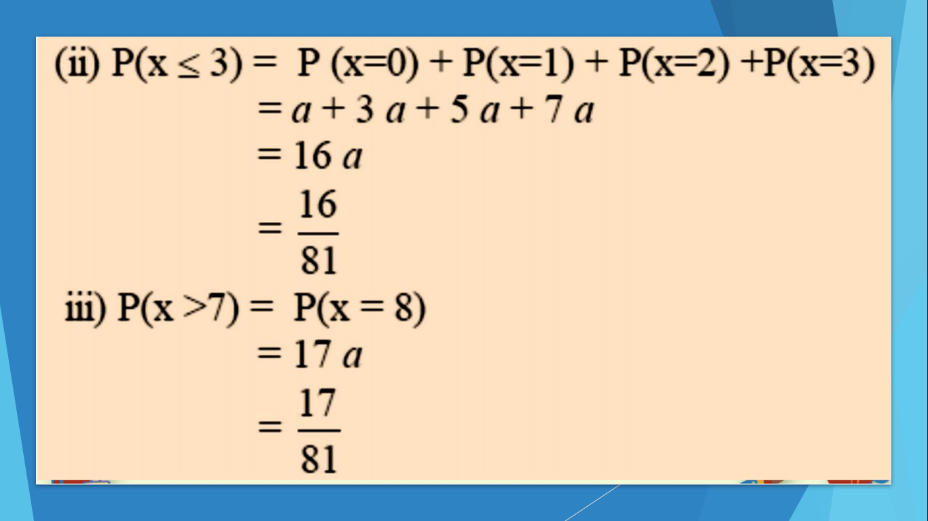
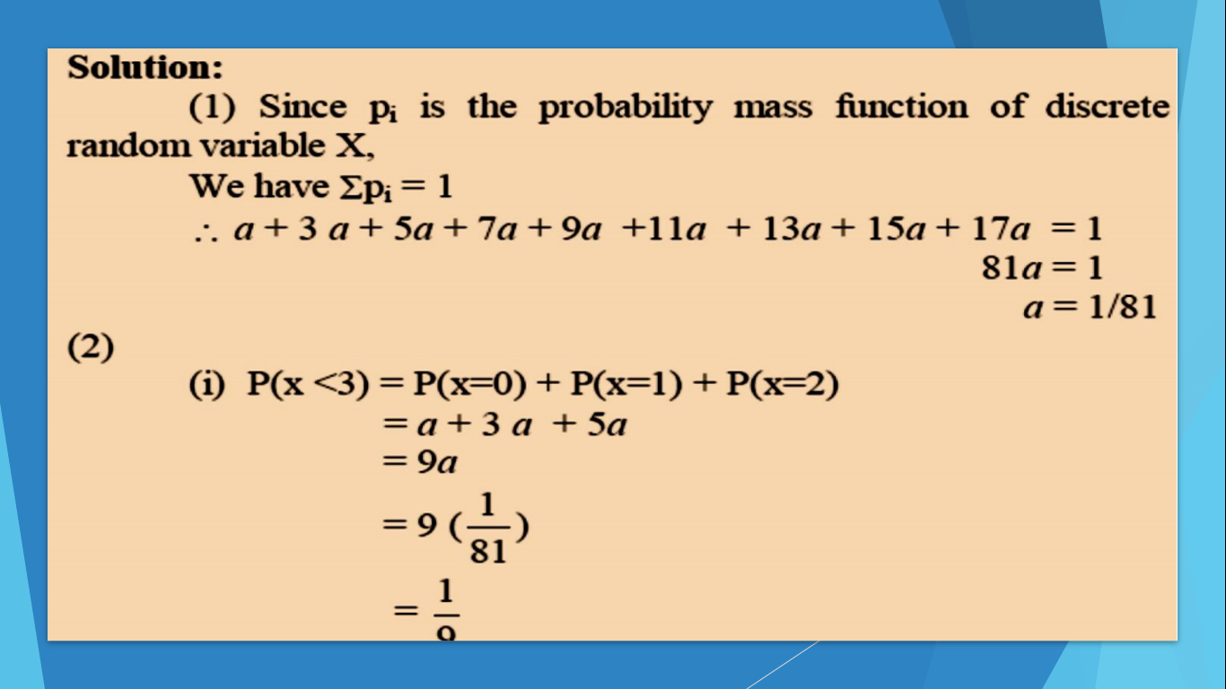
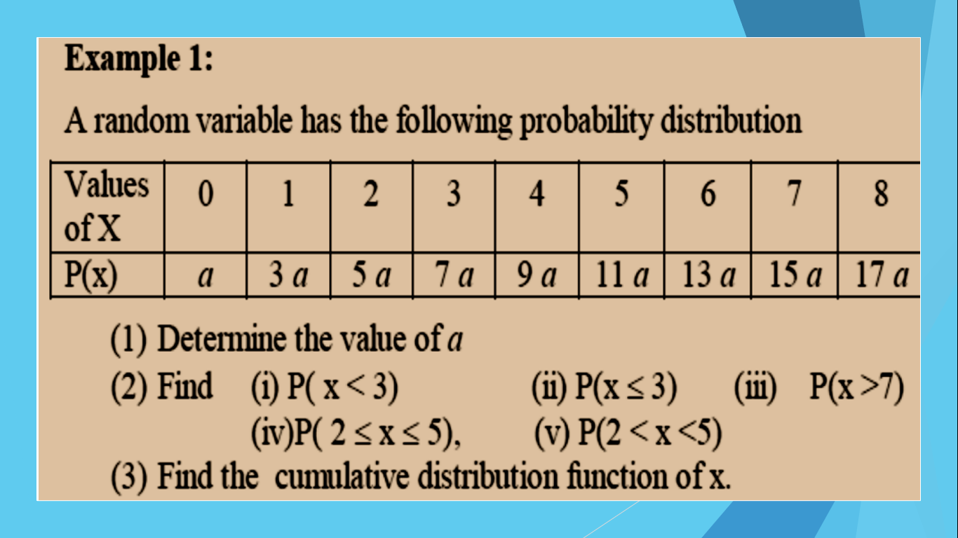
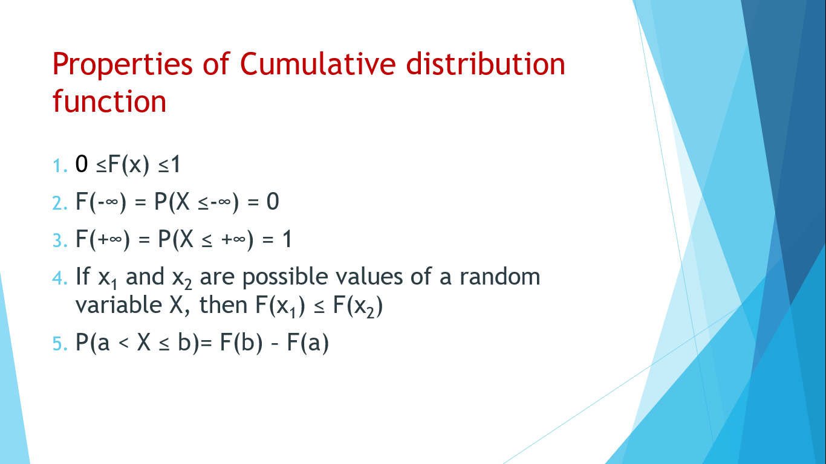
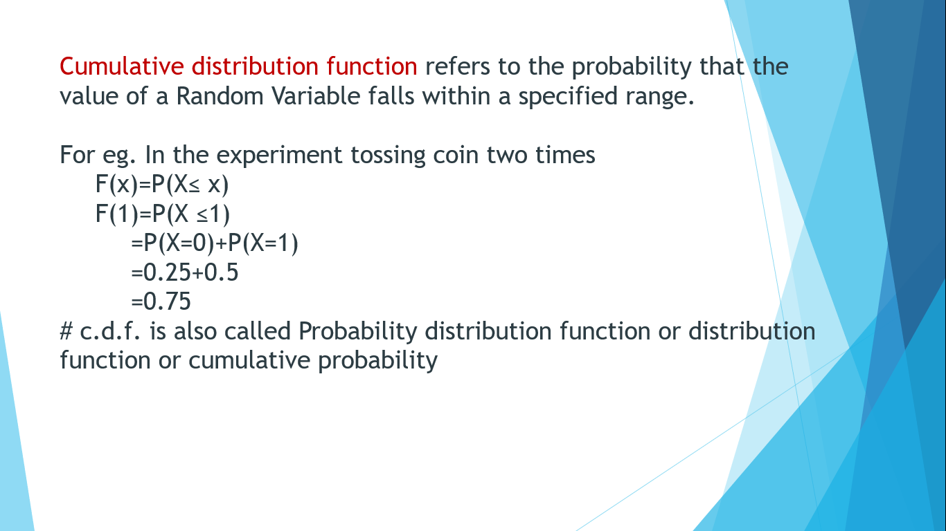
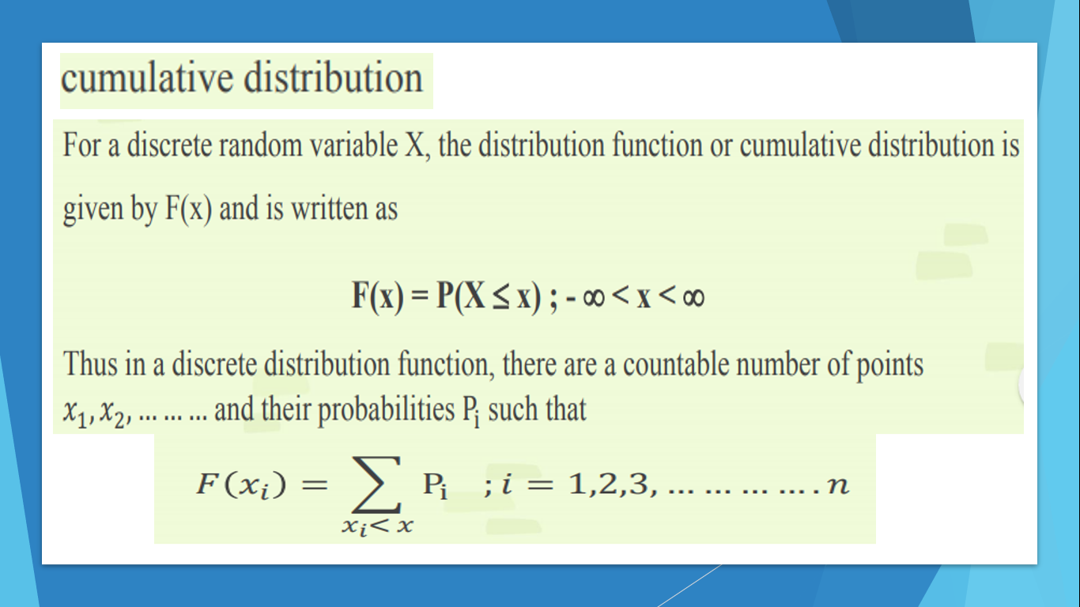
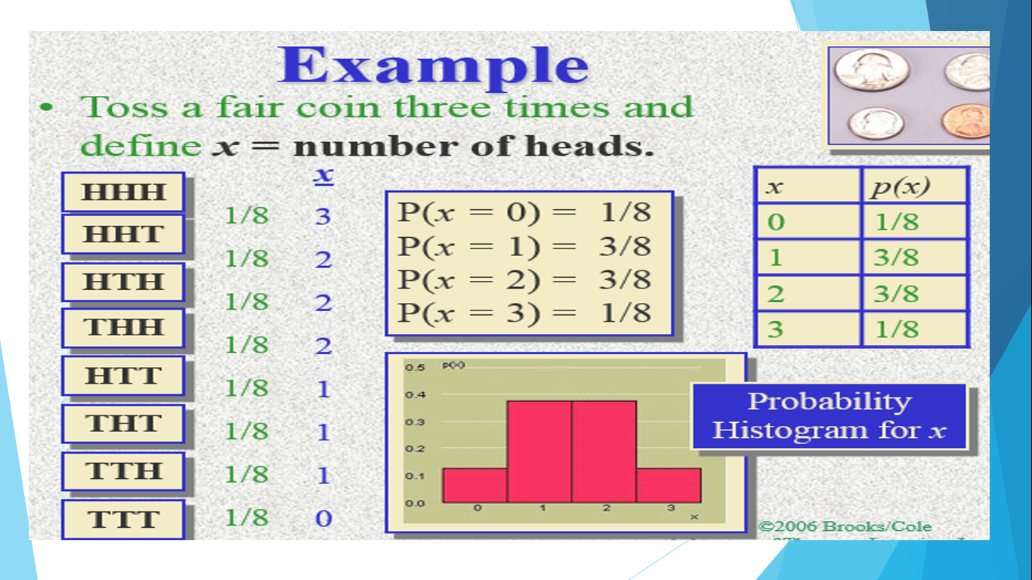
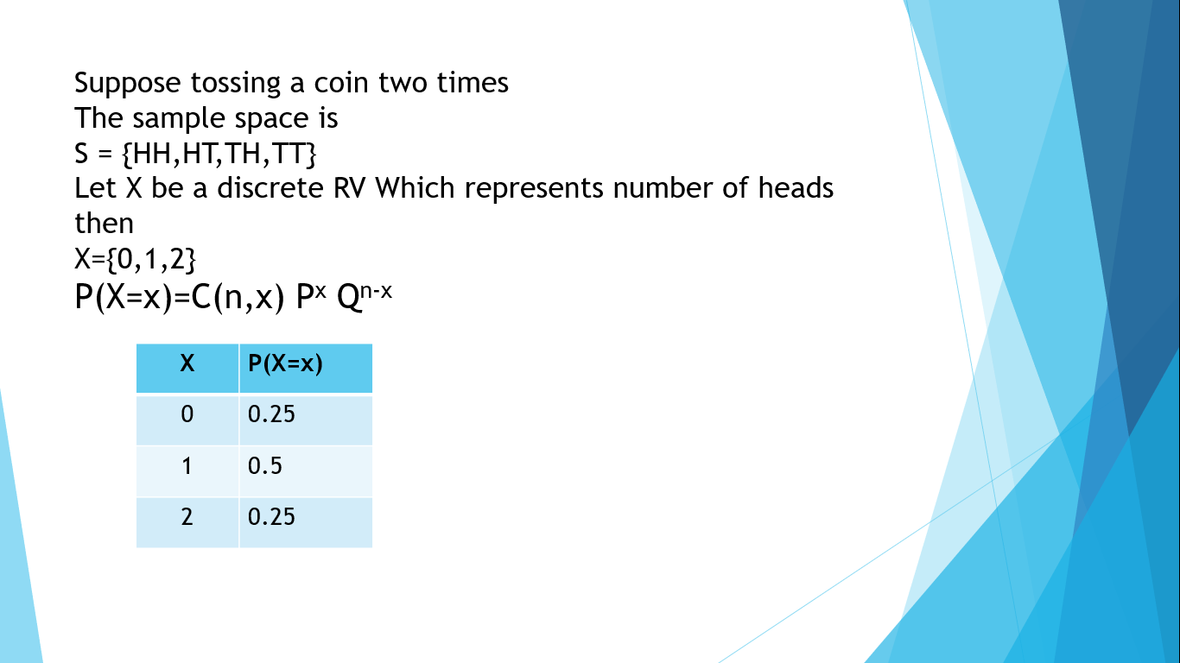
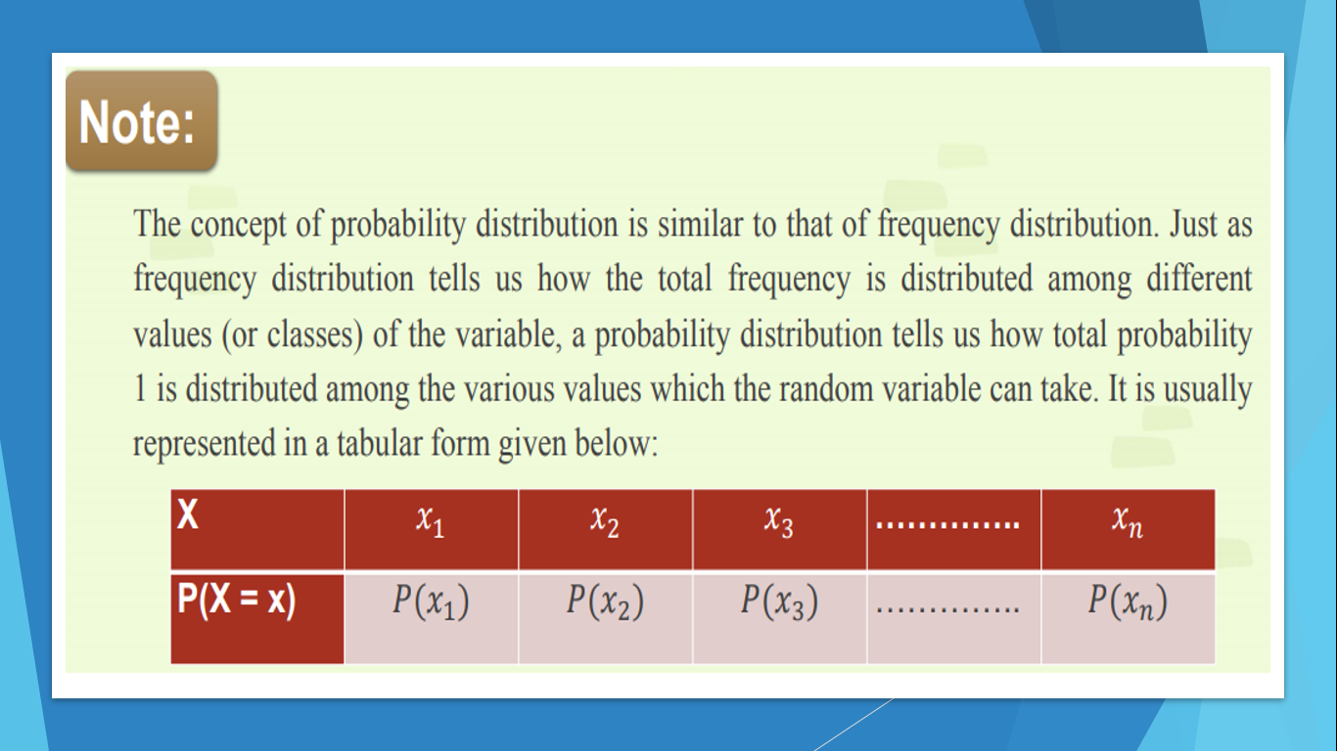
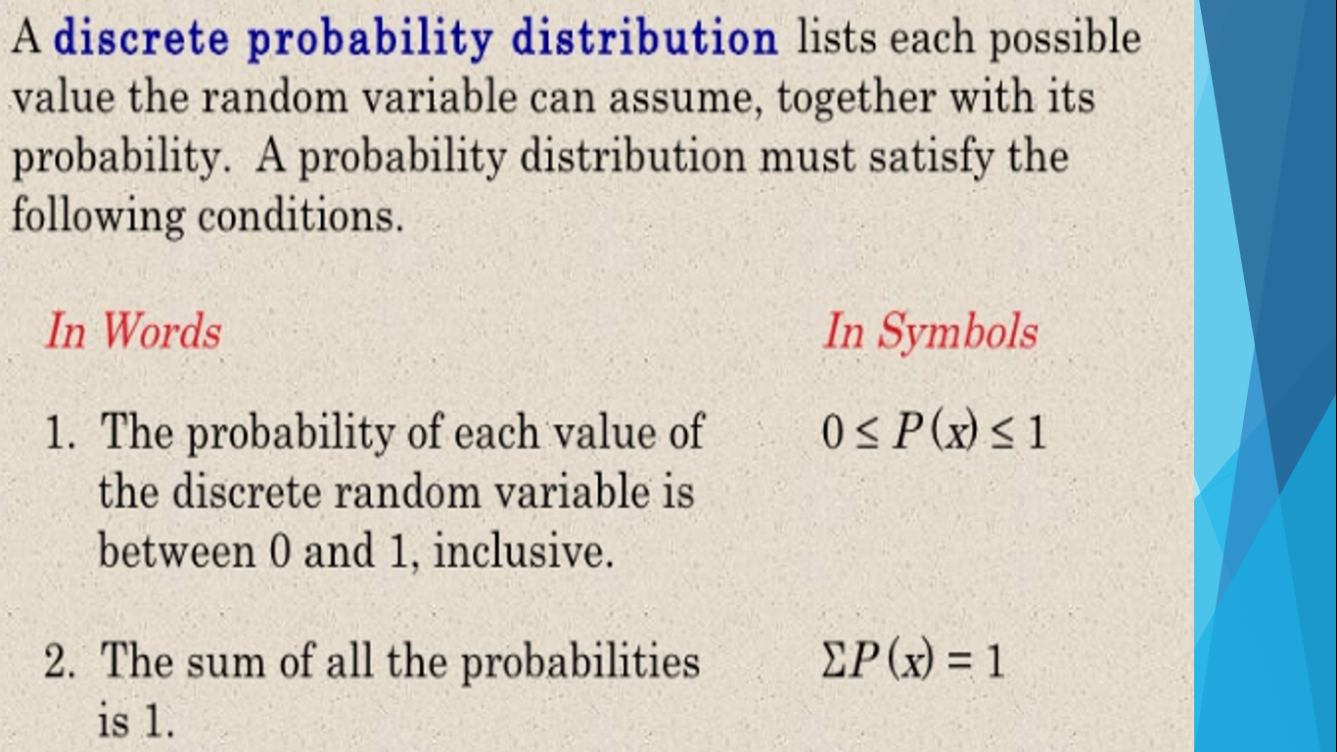
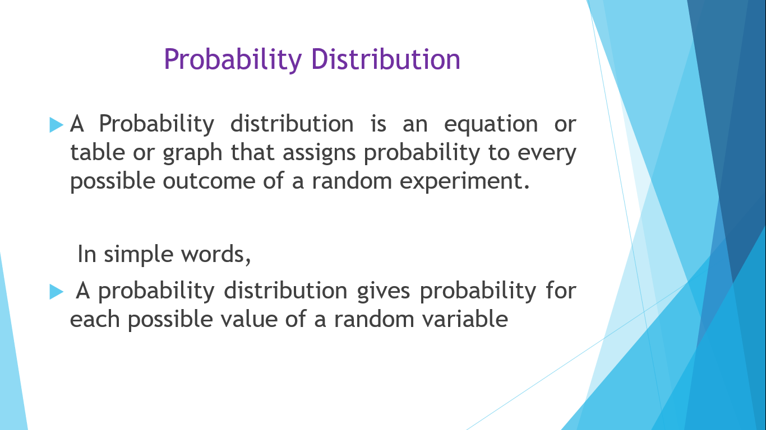
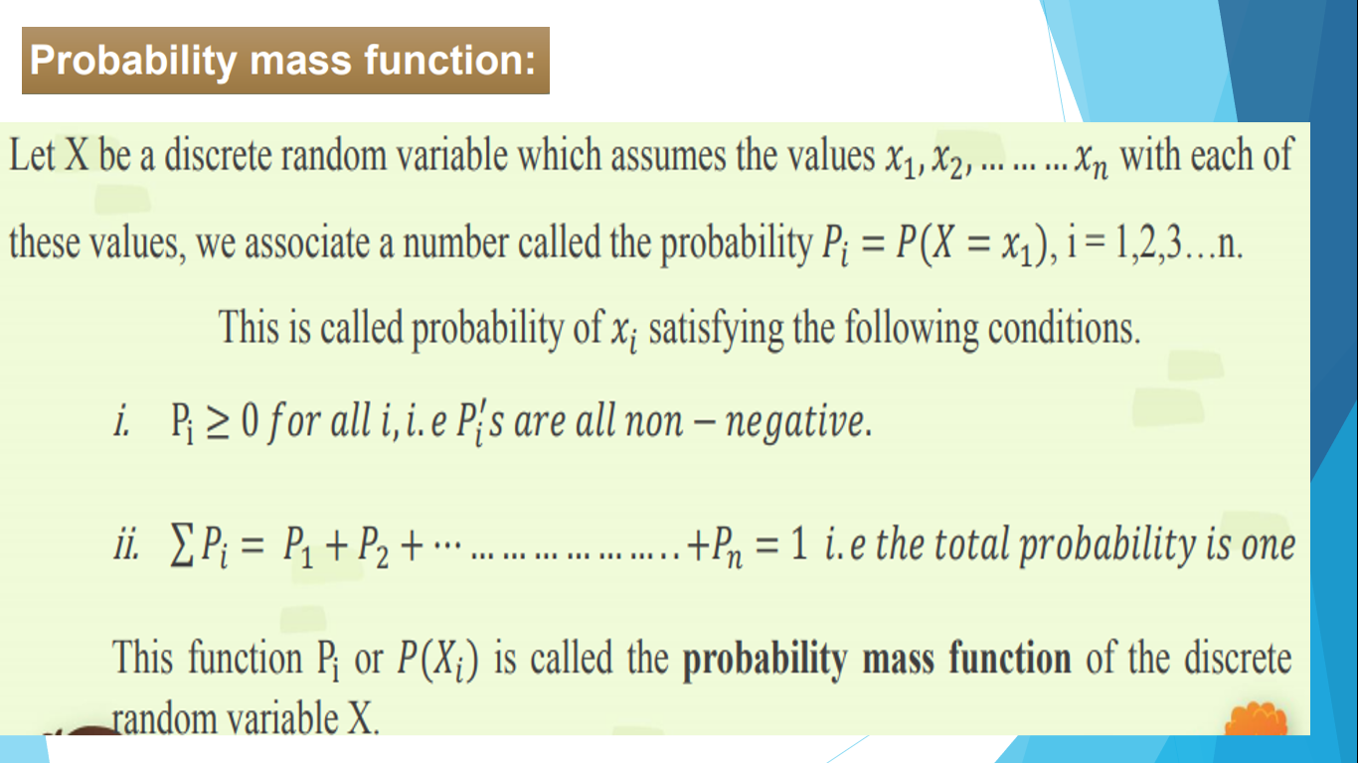
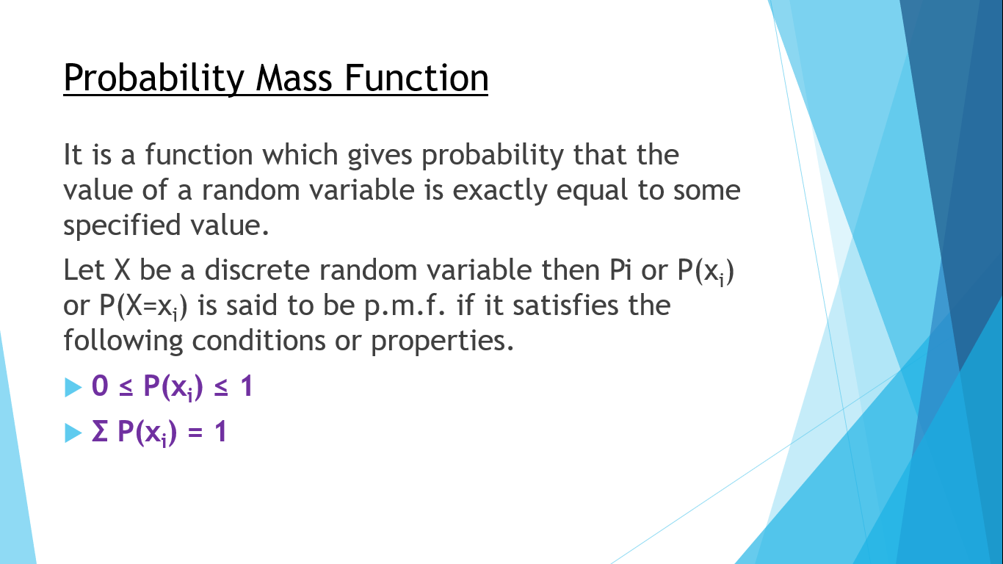
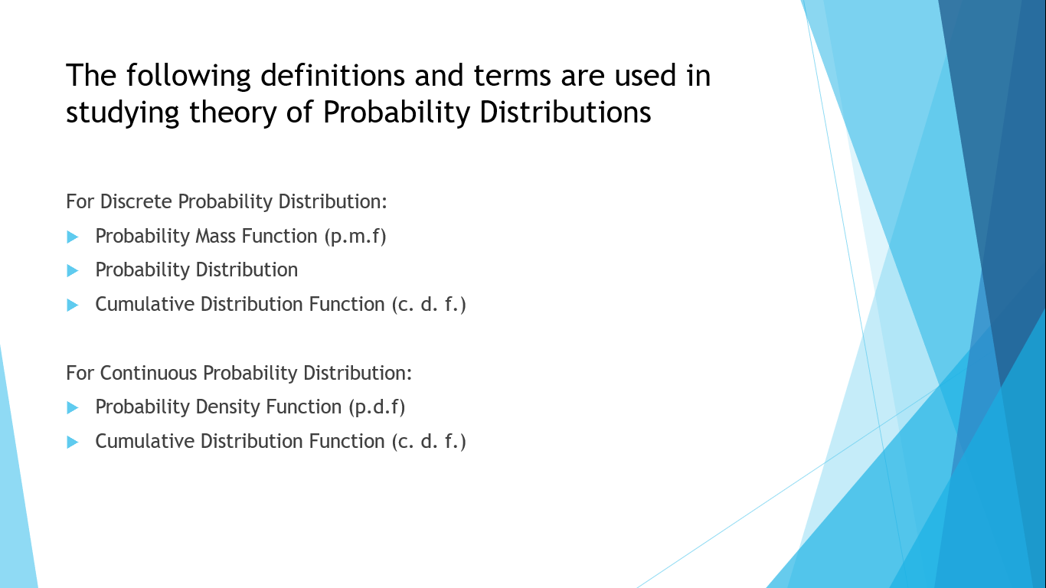
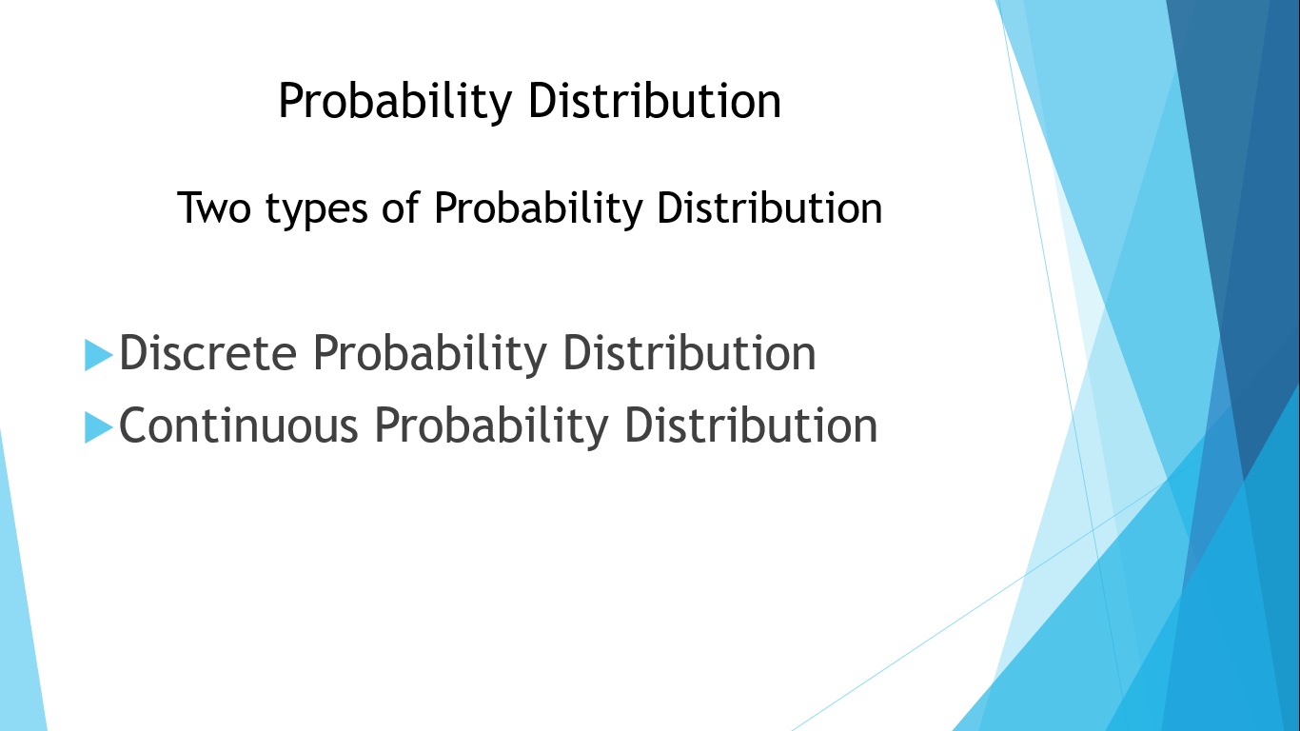
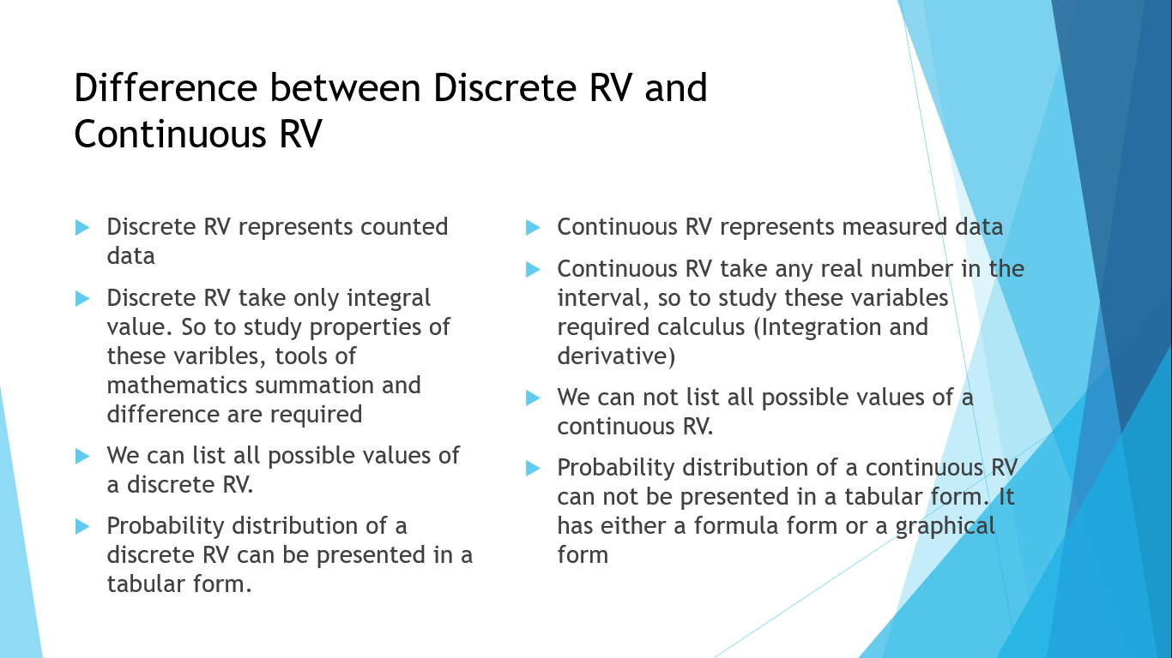

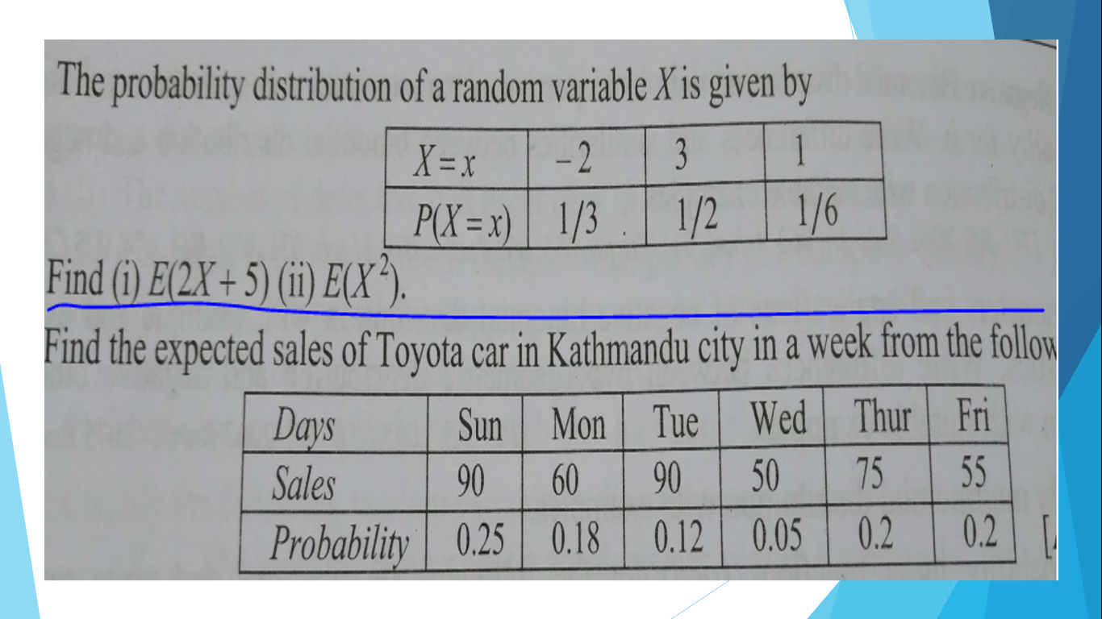

Slide 13
Normal Distribution

Slide 14


Slide 15
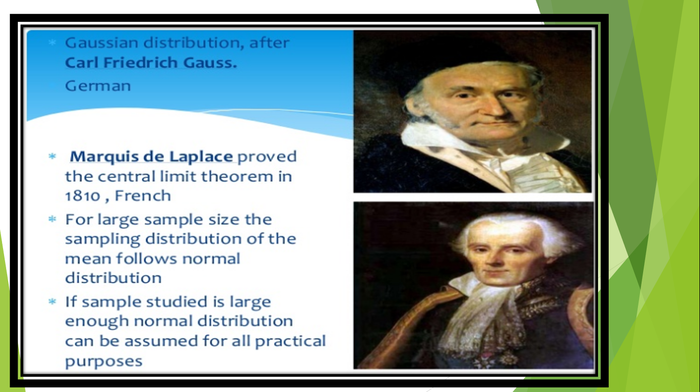

Slide 16


Slide 17
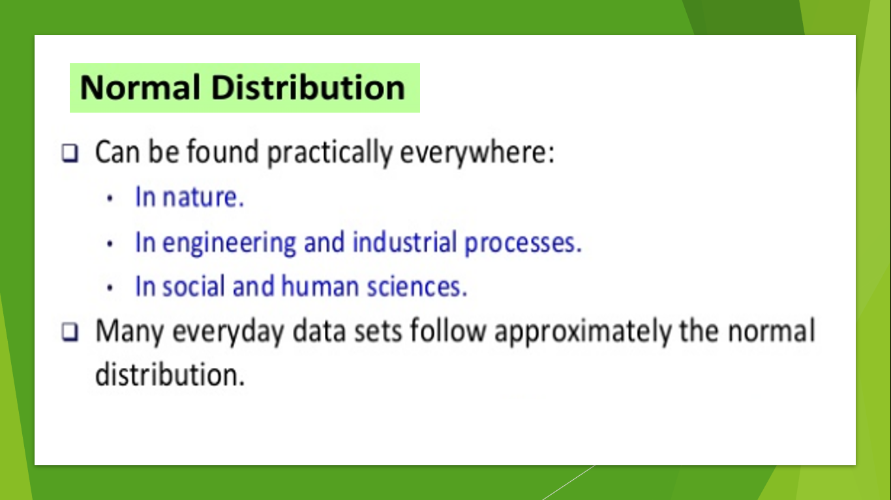

Slide 18
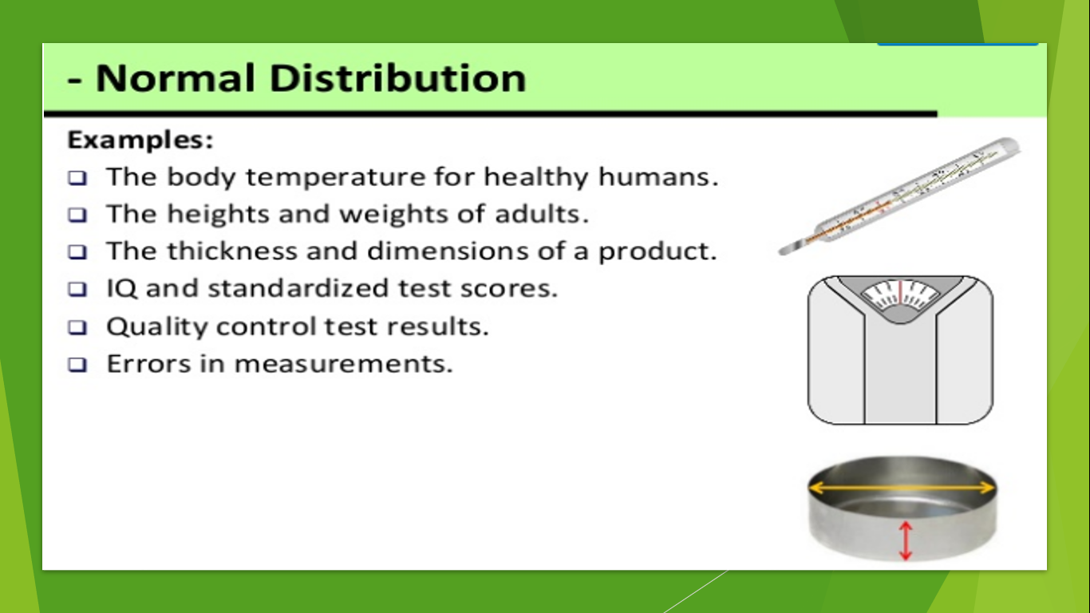

Slide 19
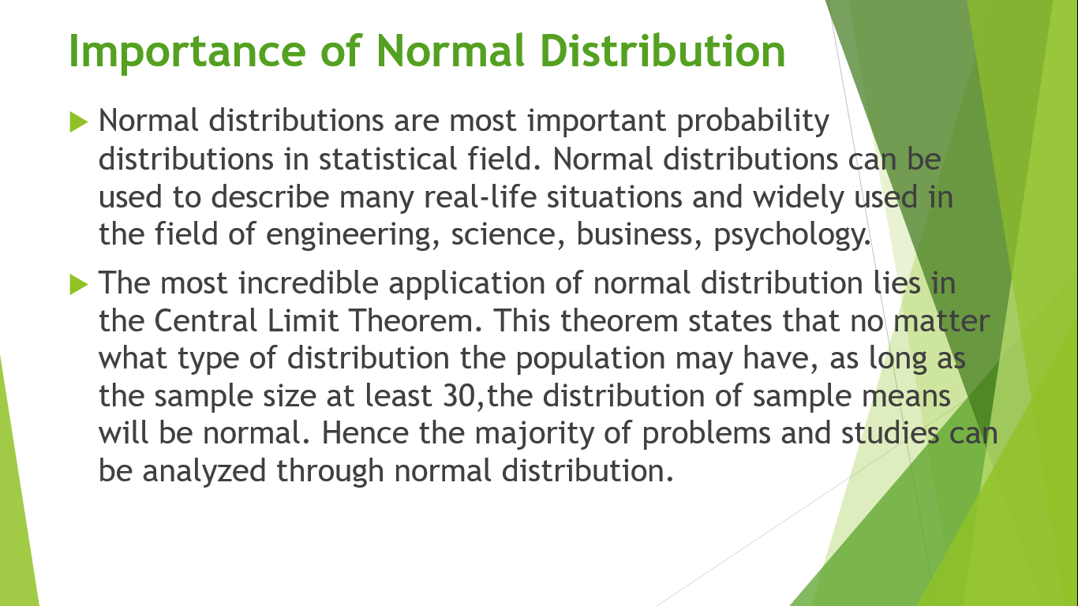

Slide 20
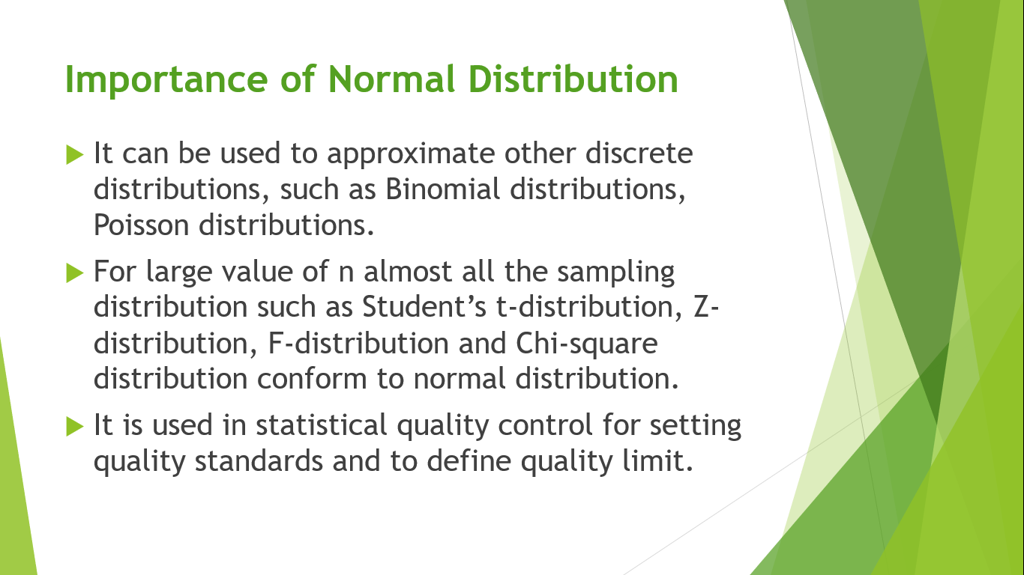

Slide 21
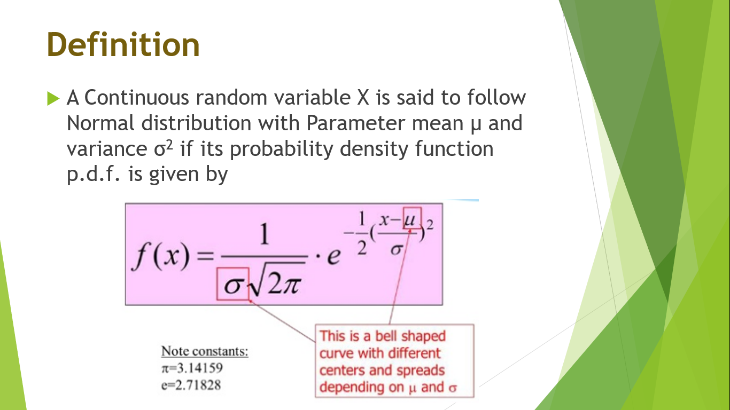

Slide 22
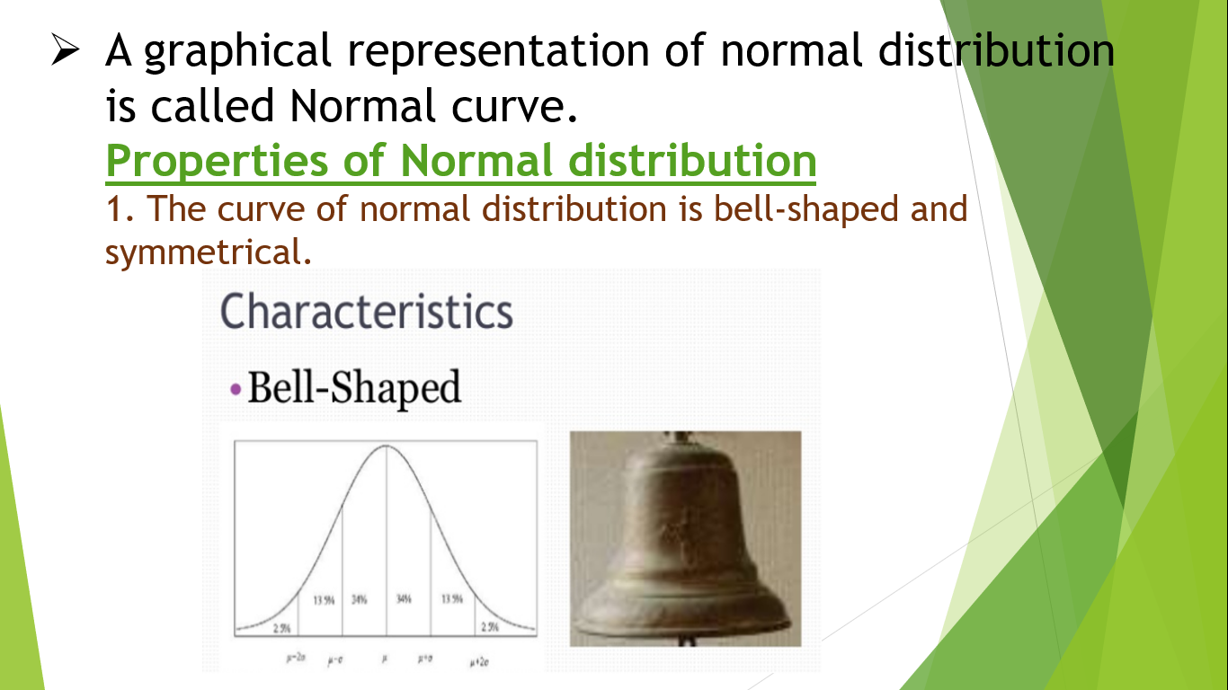

Slide 23
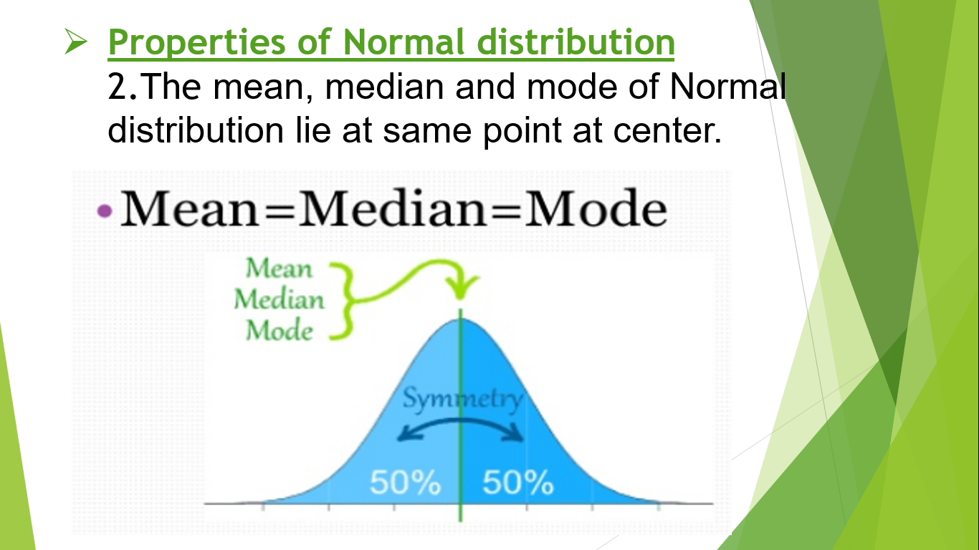

Slide 24
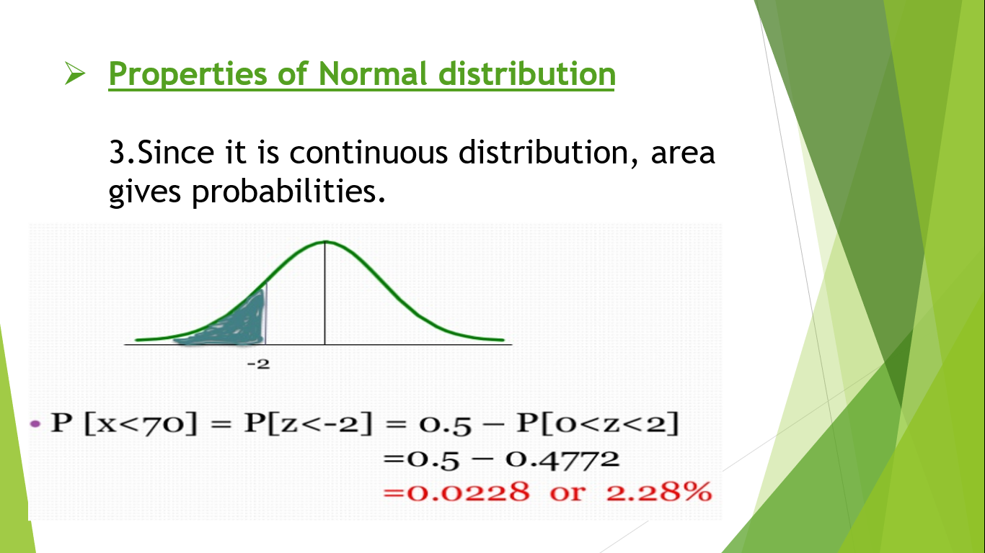

Slide 25
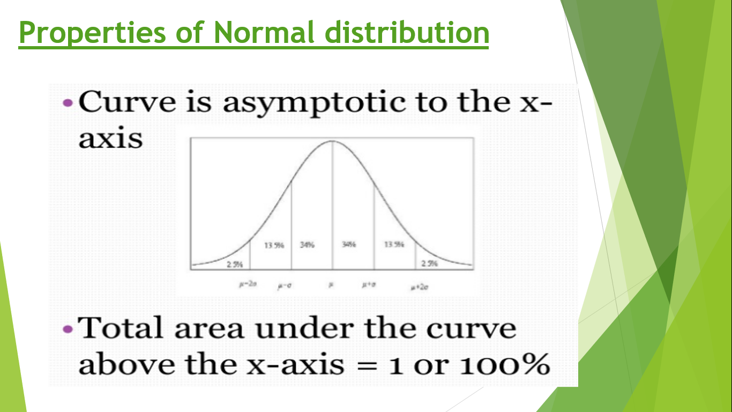

Slide 26
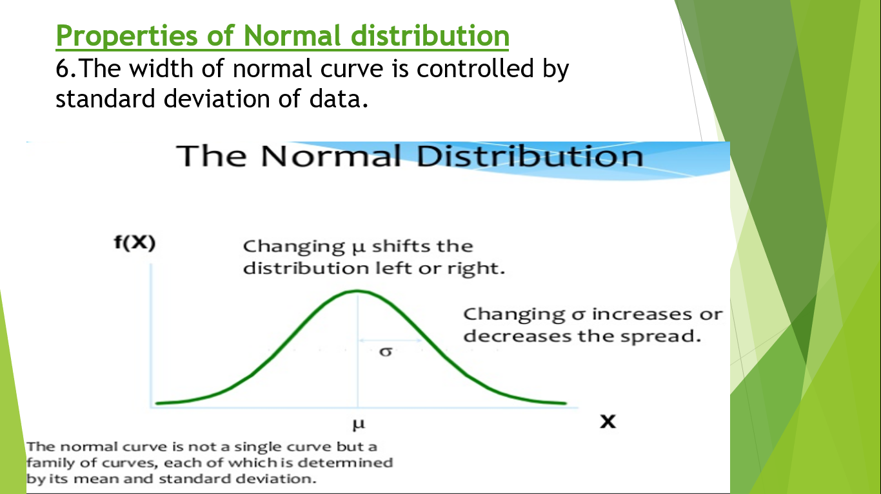

Slide 27
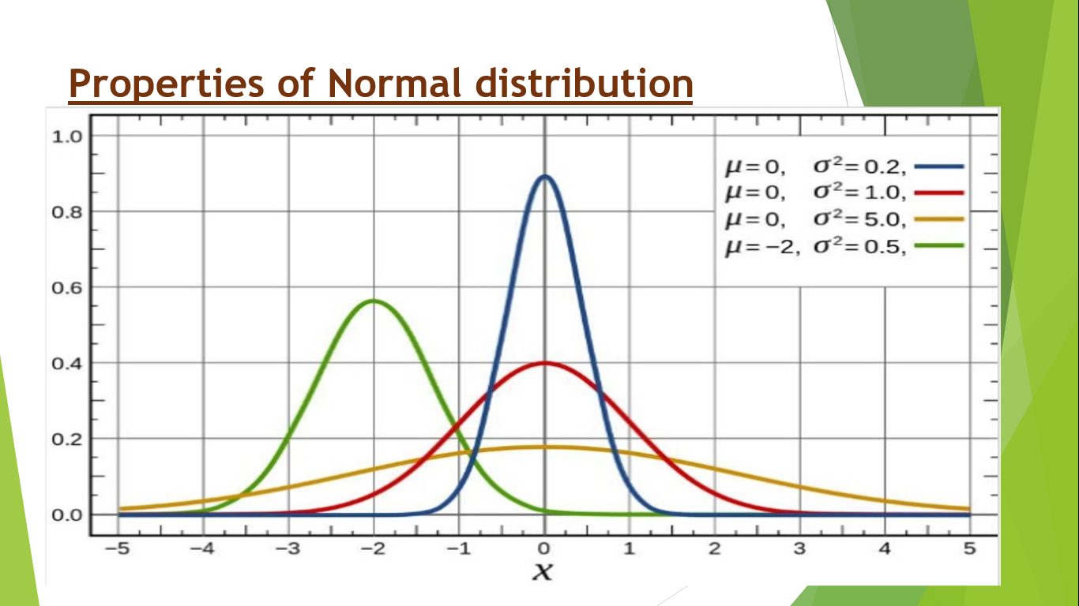

Slide 28
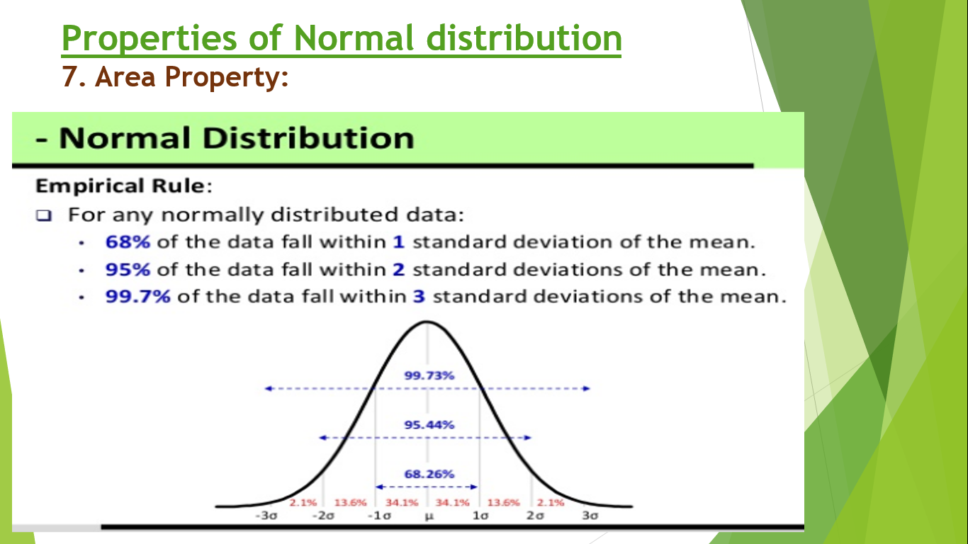

Slide 29
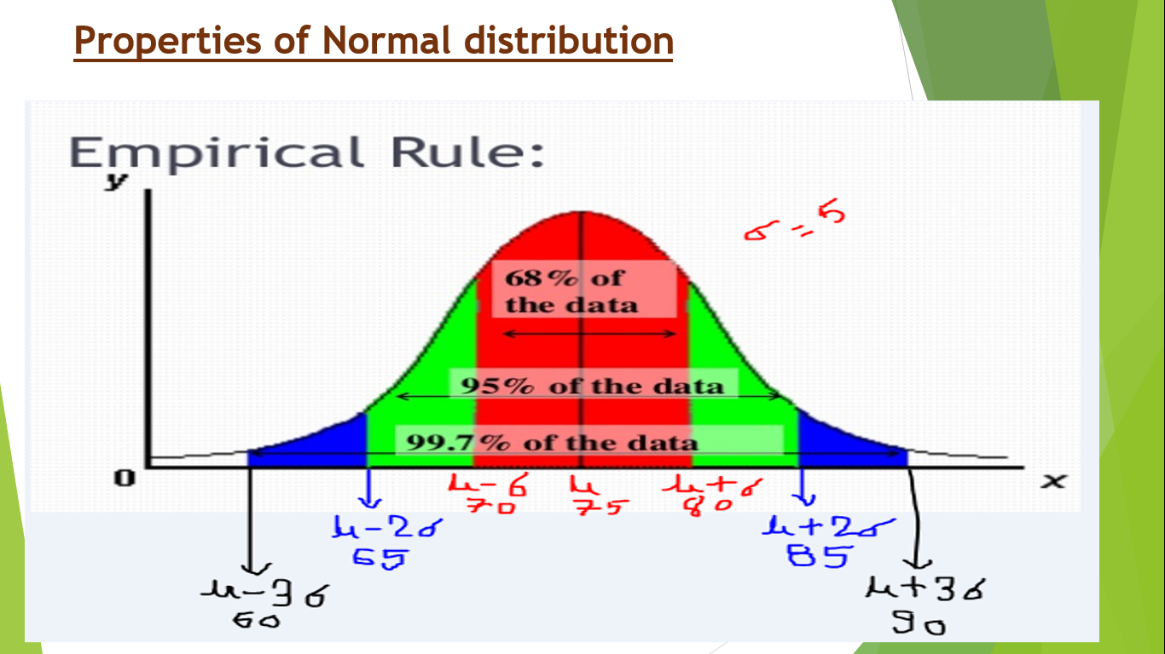

Slide 30
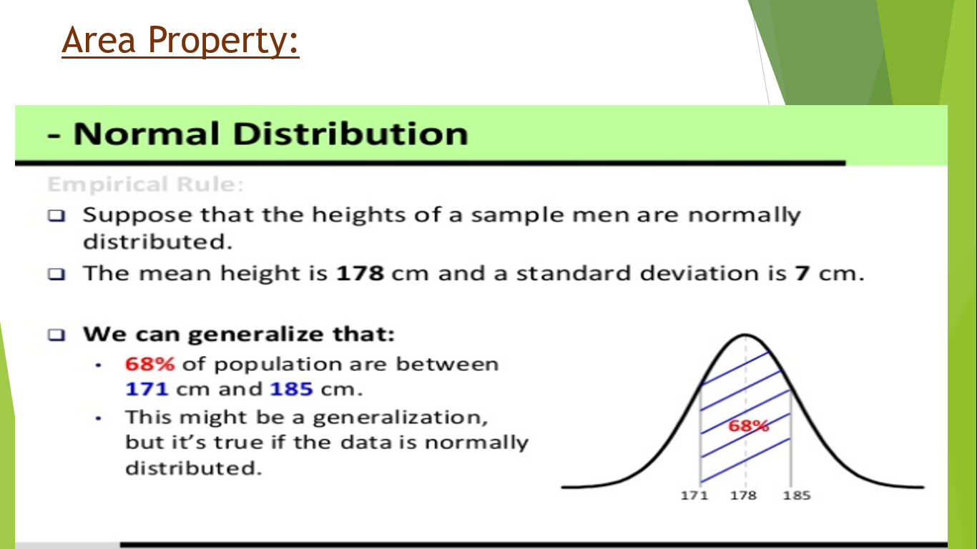

Slide 31
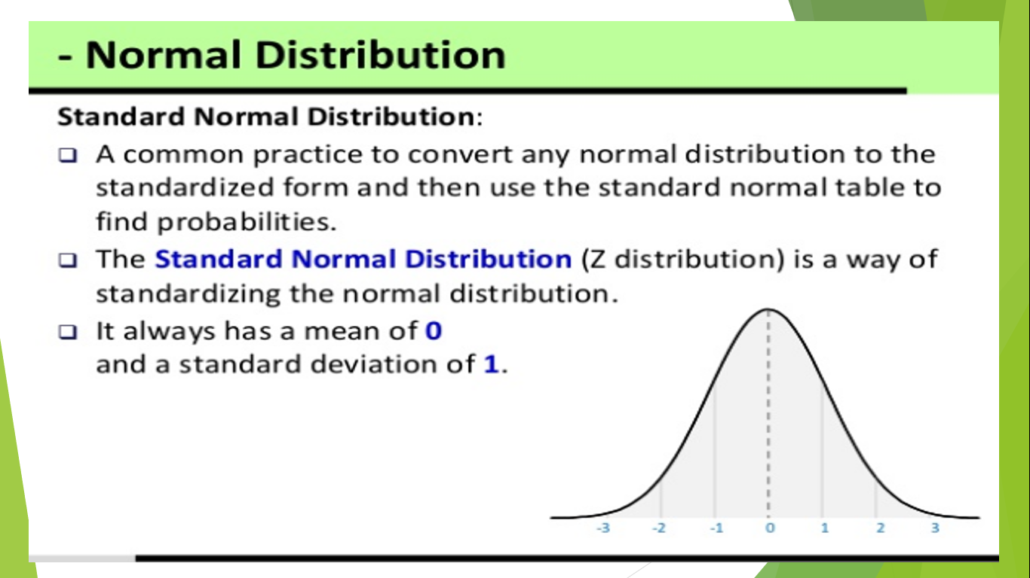

Slide 32
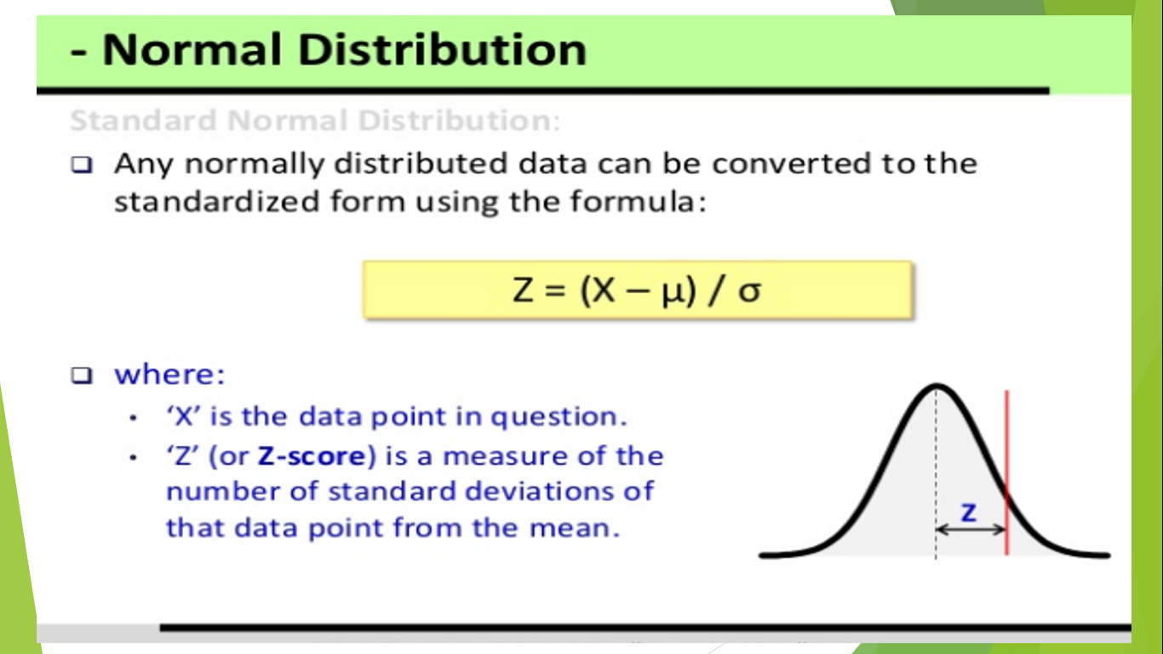

Slide 33
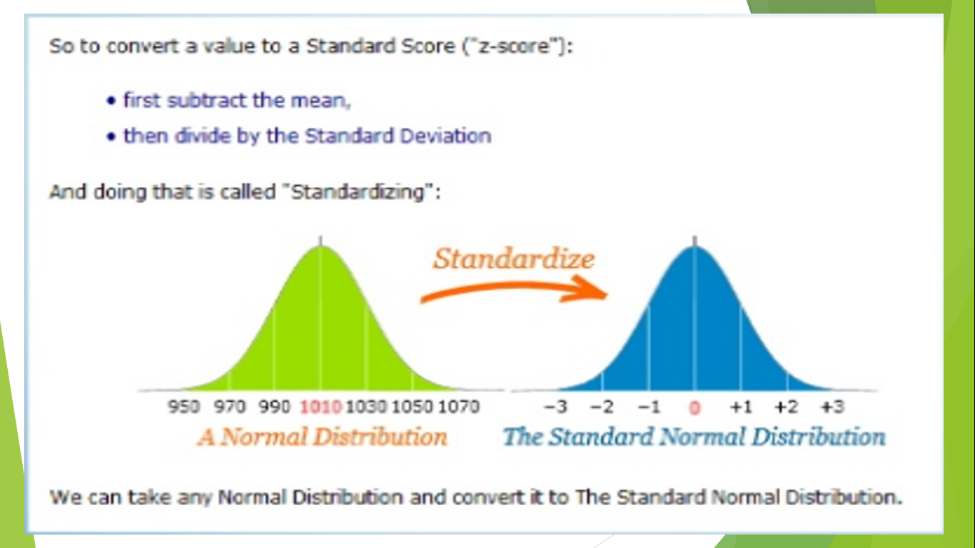

Slide 34
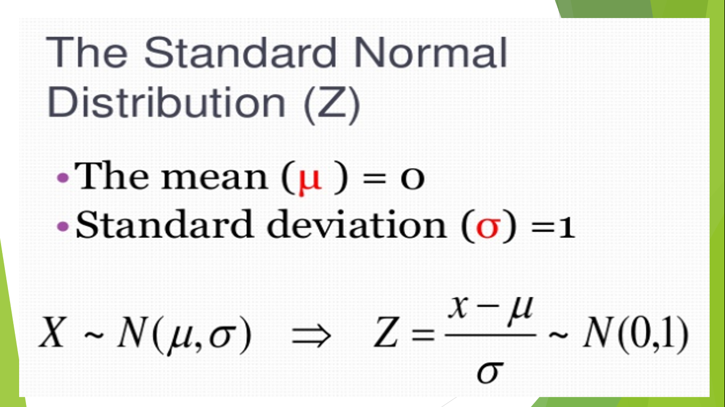

Slide 35


Slide 36


Slide 37


Slide 38


Slide 39


Slide 40


Slide 41


Slide 42


Slide 43
Numerical Problems

Slide 44
Q1. Find the probabilities of random variable having the standard normal distribution will take on a value a) between 0.87 and 1.28 b) between -0.34 and 0.62 c) greater than 0.85 d) greater than -0.65 e) less than -0.8 f) between 0 and 2.34 g) less than -0.84 or greater than 2.08
Q2. Given a normal distribution with mean= 220 and sd= 20. Find the probability that a) P(x>180) b) P(X< 220) c) P(160<x<240)
d) P(x> 220) e) P(x<180 or X> 220) f) 10% of the values are less than what x values?

Slide 45
Q3. The weight (kg) of all students in a university is normally distributed with mean of 67.55kg and standard deviation of 2.02kg.
Answer the following questions, giving answers correct to 4 decimal places.
i. Calculate the probability that probability that the weight of a randomly selected student is more than 65.8kg.
ii. Calculate the probability that the weight of a randomly selected student is between 63.9kg and 69.2kg.
iii. Find the minimum weight of top 2.5% of the student.

Slide 46
Q4. Incomes of a group of 10000 employees were found to be normally distributed with mean Rs 1520 and standard deviation Rs 160. Find a)highest income of poorest 2000 employees b) lowest income of richest 1000 employees.
Q5. The daily wages of 6000 workermen are normally distributed around mean of Rs 1200 and sd Rs. 400. Assuming that the distribution to be normal approximate a) the % of workers getting wages above Rs. 1600 b) number of workers getting wages between Rs. 400 and Rs. 800.

Slide 47
Q6. Kathmandu municipality puts 10000 light bulbs on the streets of a city. If lives of bulbs follow a normal distribution with a mean of 60 days and a standard deviation of 20 days, how many bulbs will have to be replaced after a) 40 days b) 80 days?
Q7. The IQ (intelligent quotient) score of all the people in a particular country follows a normal distribution, with an average of 100 and a standard deviation of 15. Let X be the random variable that represents the IQ score of a person in that country. Hence,(i) What is the probability that a randomly selected person has an IQ score between 85 and 110?

Slide 48
Q8. A sample of 600 dry battery cells tested to find the length of life produced the following results. Mean= 12 hours and sd= 2.5 hours. Assuming the data to be normally distributed. Find the number of battery cells that are expected to have life a) more than 15 hours b) between 14 and 16 hours c) less than 6 hours.
Q9. In a normal distribution, 31% of the items are under 45 and 8% are over 64. Find the mean and sd of the distribution.
Q10. In a normal distribution, 7% of the items are under 35 and 89% are under 63. Find the mean and sd of the distribution.
Q11. The marks obtained by 1000 students in an examination are known to be normally distributed. If 15% of the students get less than 30 marks and 10% of the students got over 90, find the mean and variance of the distribution.

Slide 49

Central Limit Theorem
Central limits theorem states that the sampling distribution of the sample means approximately follows a normal distribution for a sufficiently large sample regardless of the distribution of the population (whether it is normal or not) from which samples are drawn.
For a sufficiently large sample, sample mean (x̄) follows normal distribution with mean = μ and variance= σ²/n then
Z=(x̄ - μ)/(σ/√n)

Slide 50


Slide 51


Slide 52


Slide 53
Q1. Assume that the population of human body temperature has a mean of 98.6 degree F, as a commonly believed. Also, assume that the popln sd is 0.62 degree F. If a sample of size n= 106 is randomly selected, find the probability of getting a mean of 98.2 degree F or lower.

Slide 54
Q2. If a 1-gallon of a paint covers on the average of 513.3 square feet with sd of 31.5 square feet, what is the probability that the sample mean area covered by a sample of 40 of these 1-gallon cans be anywhere from 510 to 520 square feet?

Slide 55
Q3. Assume that the weights of all packages of a certain brand of cookies are normally distributed with a mean of 32 ounces and a standard deviation of .3 ounce. Find the probability that the mean weight of a random sample of 20 packages of this brand of cookies will be between 31.8 and 31.9 ounces.
Q4. The electronics company manufactures resistors that have a mean resistance of 100 ohms and a standard deviation of 10 ohms. The distribution of resistance is normal. Find the probability that a random sample of 25 resistors will have an average resistance less than 95 ohms.
Q6. The lifetime of a certain brand of electric bulb may be considered a random variable with mean 1200 hours and sd 250 hours. Find the probability that the sample mean, of the lifetime with a sample of size 36 is between 1100 hours and 1300 hours.

Slide 56
Mixed practice question
Q1. The weight (kg) of all students in a university is normally distributed with mean of 67.55kg and standard deviation of 2.02kg.
Answer the following questions, giving answers correct to 4 decimal places.
i. Calculate the probability that probability that the weight of a randomly selected student is more than 65.8kg.
ii. Calculate the probability that the weight of a randomly selected student is between 63.9kg and 69.2kg.
iii. Find the minimum weight of top 2.5% of the student.
iv. Find probability that the mean weight of a random sample of 100 students is between 67.25kg and 68.21kg.

Slide 57
Q2. The weekly salaries paid to employees are normally distributed with mean of $800 and standard deviation of $100. Give your answers correct to 4 decimal places:
i. Find the probability that a randomly selected employee’s weekly salary is between $700 and $900.
ii. Find the probability that a randomly selected employee’s salary is more than $950
iii. Find the probability that a randomly selected employee’s salary between $550 and $750

Slide 58
Q3. The manufacturer of cans of salmon that are supposed to have a net weight of 120 g tells you that the net weight is actually a random variable with a mean of 121 g and a standard deviation of 3.6 g. Suppose that you take a random sample of 36 cans.
a. Find the probability that the sample mean will be less than 119.4g.
b. Find the probability that the sample mean will be more than 120.7g.
c. Find the probability that the sample mean will be within 0.5g of the population mean.
Q4. The amount of time that university lecturers devote to their jobs per week is normally distributed, with a mean of 52 hours and a standard deviation of 6 hours.
a. What is the probability that a lecturer works for more than 60 hours per week?
b. Find the probability that the mean amount of work per week for three randomly selected lecturers is more than 60 hours.
c. Find the probability that if three lecturers are randomly selected, all three work for more than 60 hours per week.

Slide 59
Q5. According to Moebs Services Inc., an individual checking account at major U.S. banks costs the banks between $350 and $450 per year (Time, November 21, 2011). Suppose that the current average cost of all checking accounts at major U.S. banks is $400 per year with a standard deviation of $30. Let be the current average annual cost of a random sample of 225 individual checking account at major banks in America.
(a) What is the probability that the average annual cost of the checking accounts in this sample is within $4 of the population mean?
(b) What is the probability that the average annual cost of the checking accounts in this sample is less than the population mean by $2.70 or more?

Slide 60
Q6. A sample of 100 mobile battery cells tested to find the length of life produced the following results as 13 months and sd of 3 months. Assuming the normal distribution what percentage of battery cells expected to have average life a) more than 15 months b) less than 9 months?

